Slide 1






Basket Boost
PROJECT PROPOSAL
Maximize your profits with every sale
Basket-Boost Website
Presented By: Kusum Pareek
Mentor: Mrs. Swati Bhat

Slide 2


Introduction
Market basket analysis is a data mining technique that helps retailers increase sales by understanding customer purchasing patterns. It involves analyzing purchase history to identify product groupings and items likely to be purchased together. By using this information, retailers can optimize product placement, create product bundles, and offer special deals to encourage additional sales. This approach improves the shopping experience for customers, potentially leading to stronger brand loyalty and increased sales for the retailer.
Basket-Boost Website

Slide 3

Existing System
There are various tools to analyze data and get insights from it.
These tools are using multiple algorithms to get the best out of data.
How useful the insights are generated depends a lot on what type of data is used and how it is pre- processed and cleaned.
Basket-Boost Website

Slide 4

Proposed System
Users from multiple organizations can access the website and can upload a CSV to retrieve their transaction data.
Pandas or NumPy libraries will be used to pre-process the data and identify patterns and associations between purchased items using Apriori, FP Growth, or Association Rules.
Insights will be derived in the form of charts or recommendations to help improve the sales of an organization.
Basket-Boost Website

Slide 5



Tech Stack Front-end
Bootstrap 5
Basket-Boost Website

Slide 6


Tech Stack Back-end

Slide 7




Project Modules
User Module Users can add/delete files.
Dashboard
Admin Module
Users can view insights drawn after analyzing the data.
Users can download it in png format on their local machine.
Admin is an organization.
It can add/remove members that can use this tool.
Users can preprocess and analyze the data to draw insights.
Basket-Boost Website

Slide 8
UML Diagrams
Basket-Boost Website

Slide 9
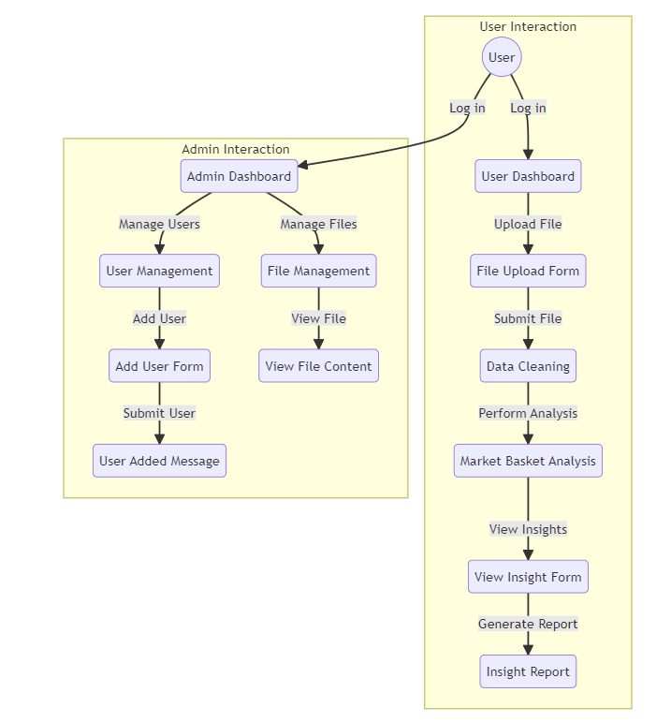
Flow Diagram

Slide 10
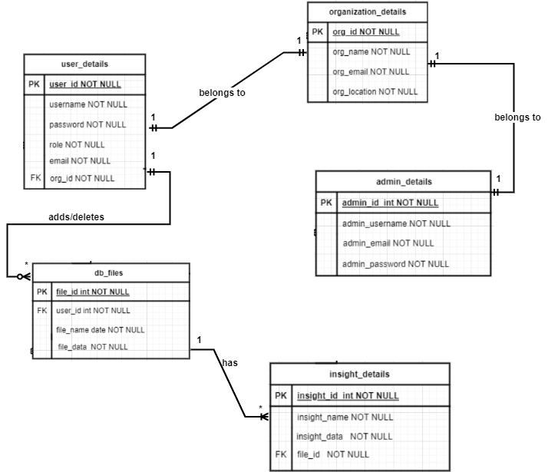
ER - Diagram

Slide 11
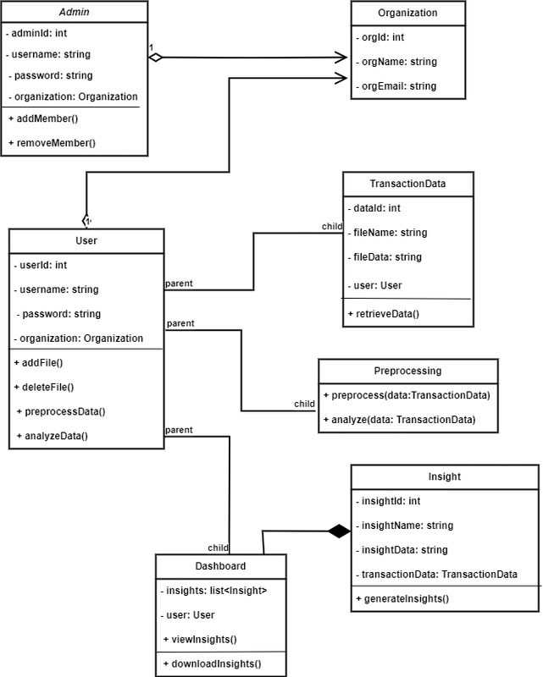
Class Diagram

Slide 12
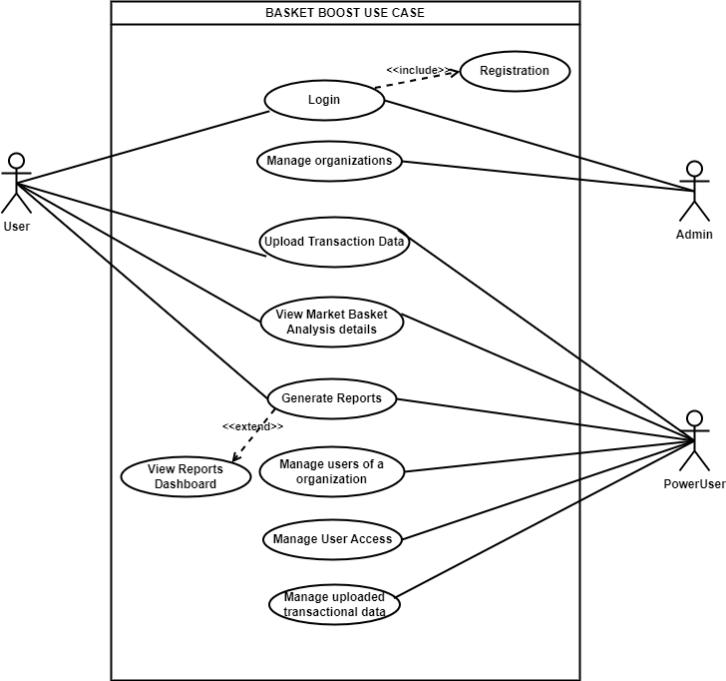
Use Case Diagram

Slide 13
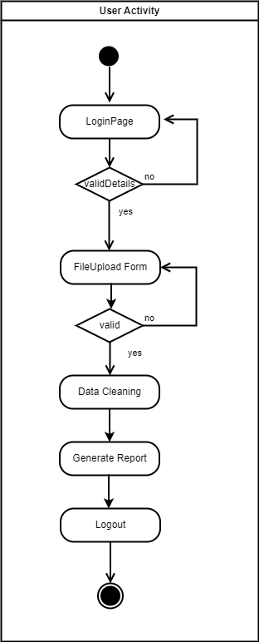
User Activity Diagram

Slide 14
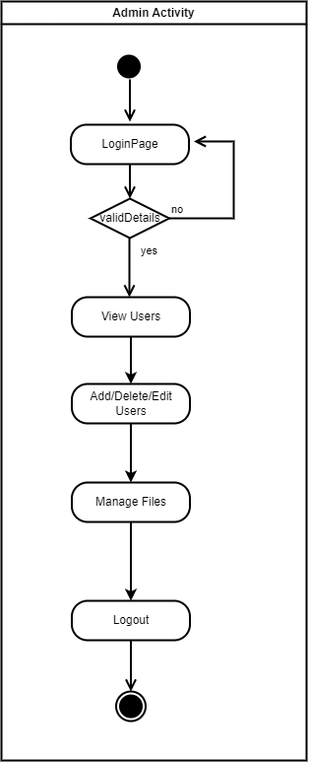
Admin Activity Diagram

Slide 15
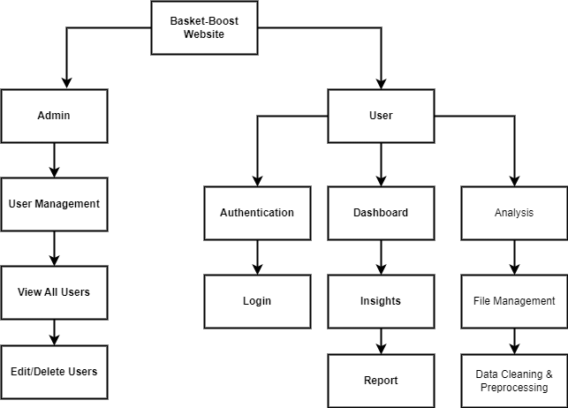
Module
Hierarchy Diagram

Slide 16

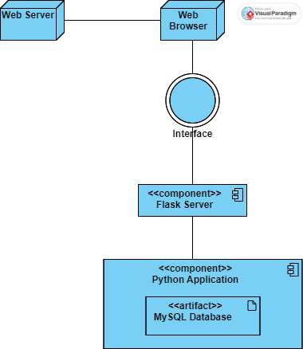
Deployment Diagram

Slide 17
UI Screens
Basket-Boost Website

Slide 18
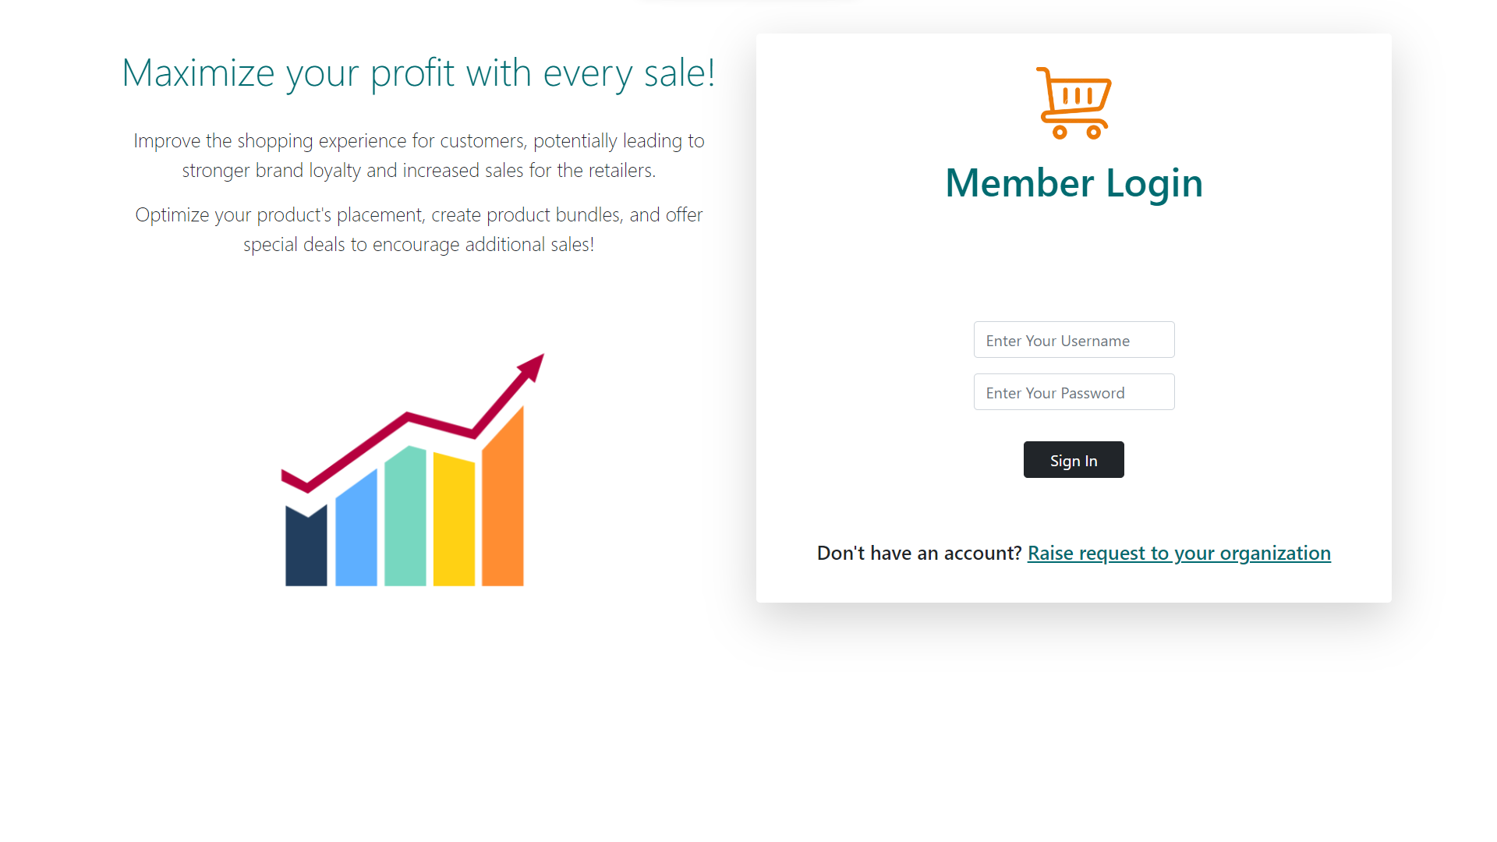
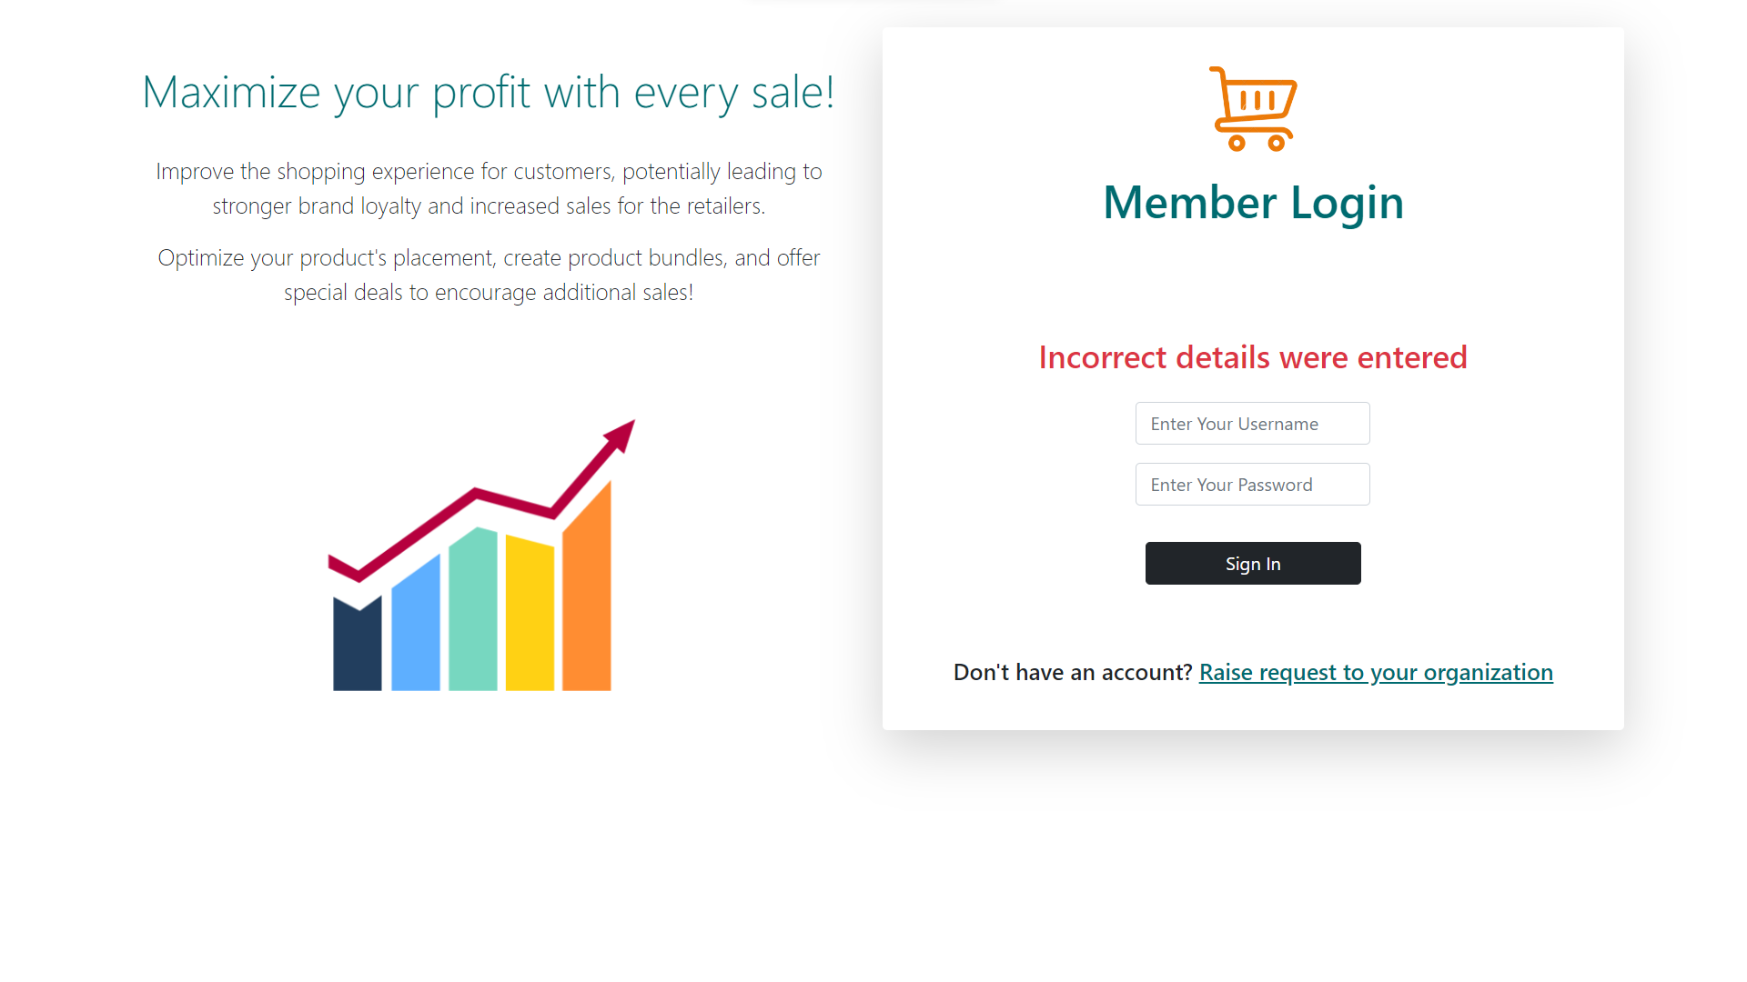
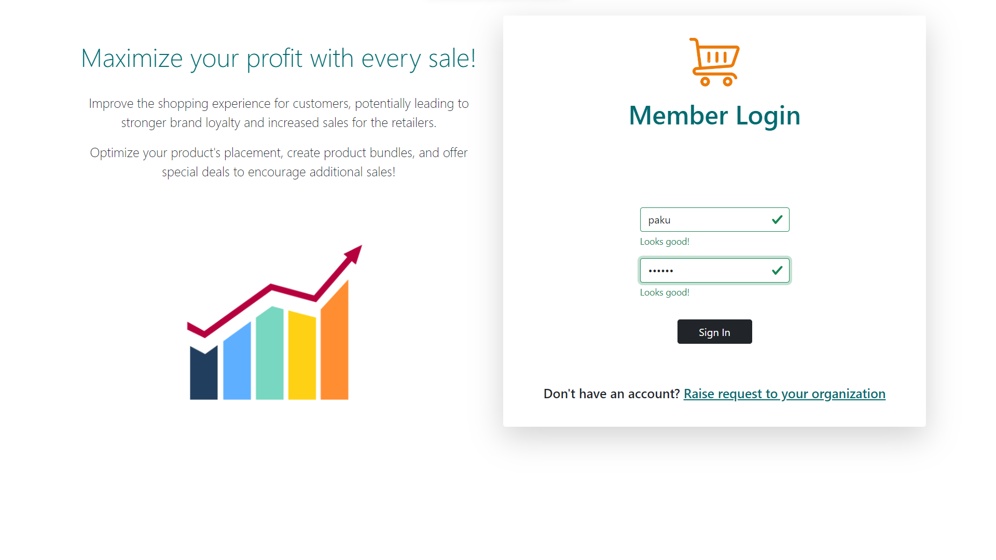
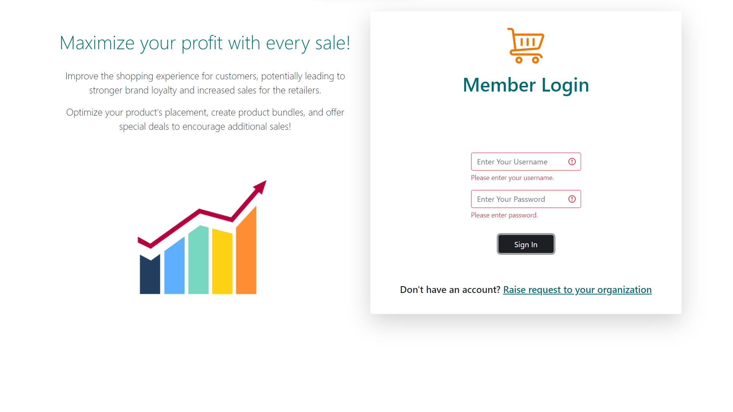

Slide 19
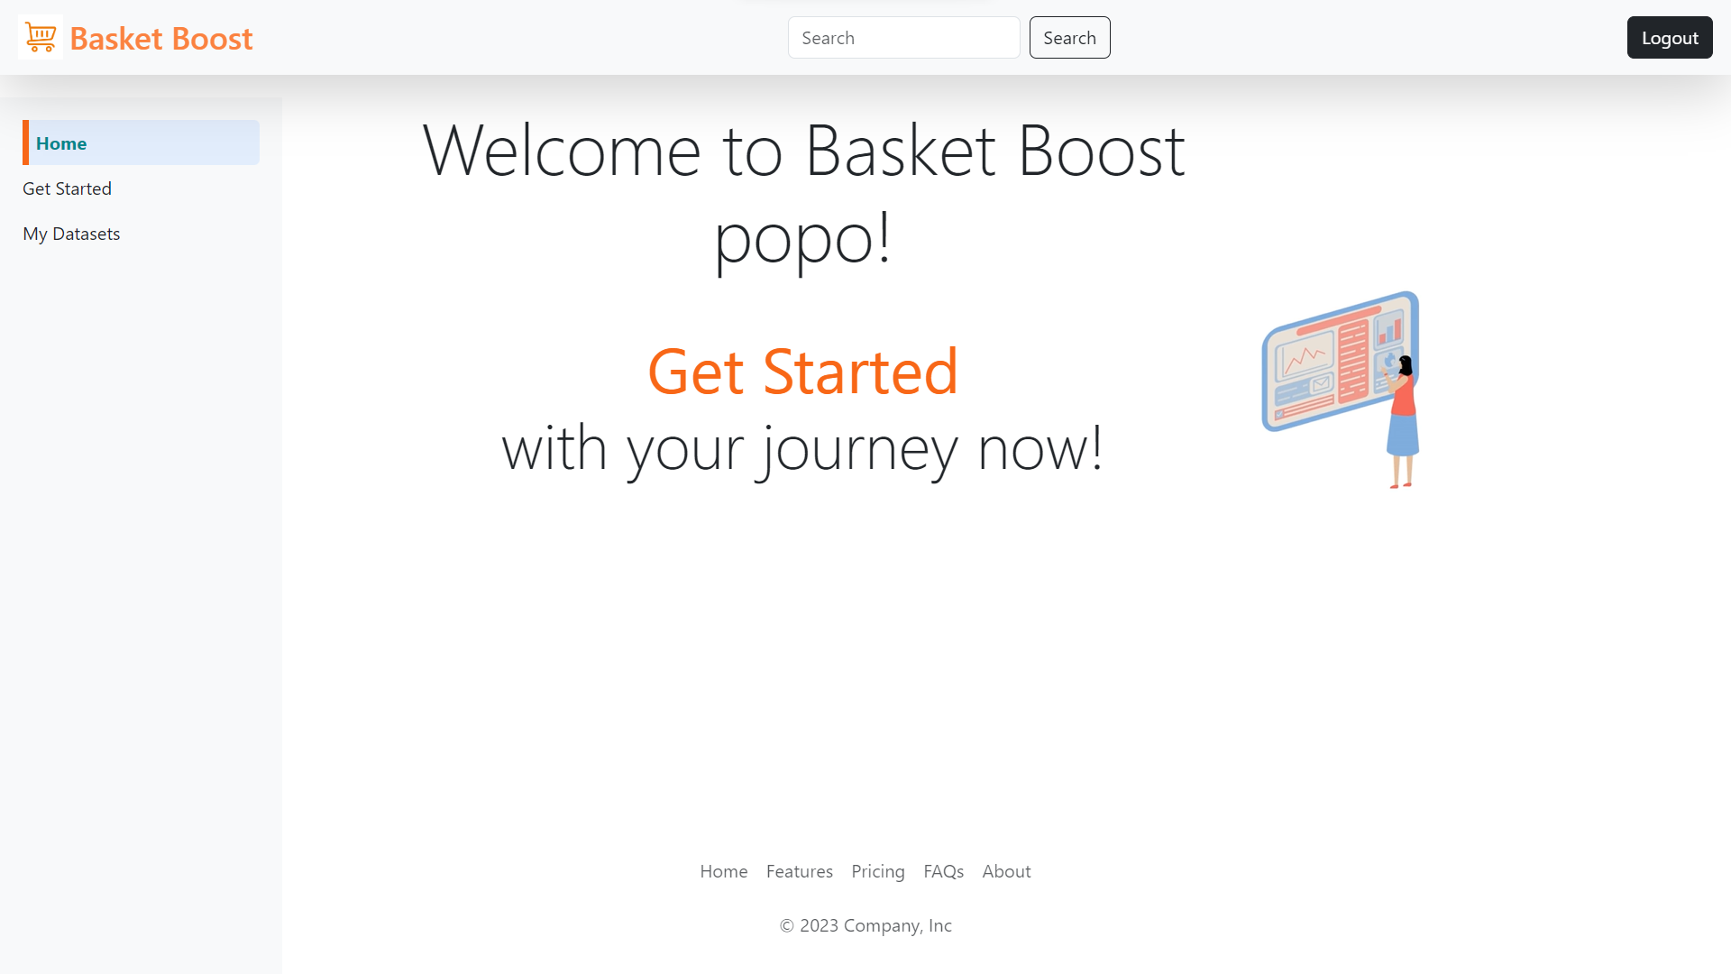

Slide 20
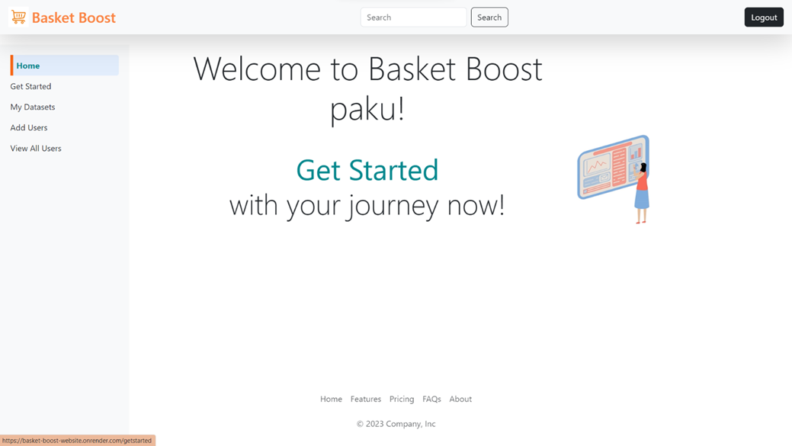

Slide 21
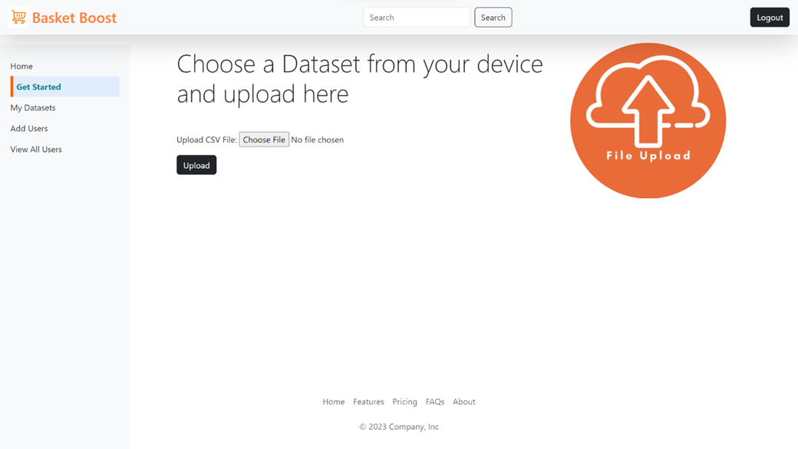

Slide 22
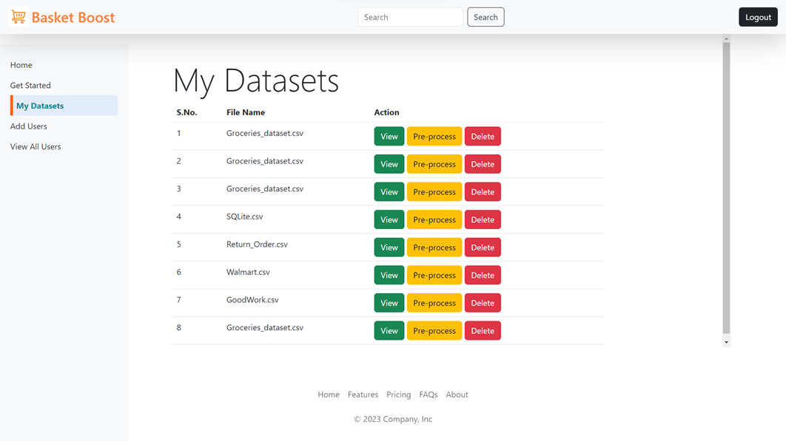

Slide 23
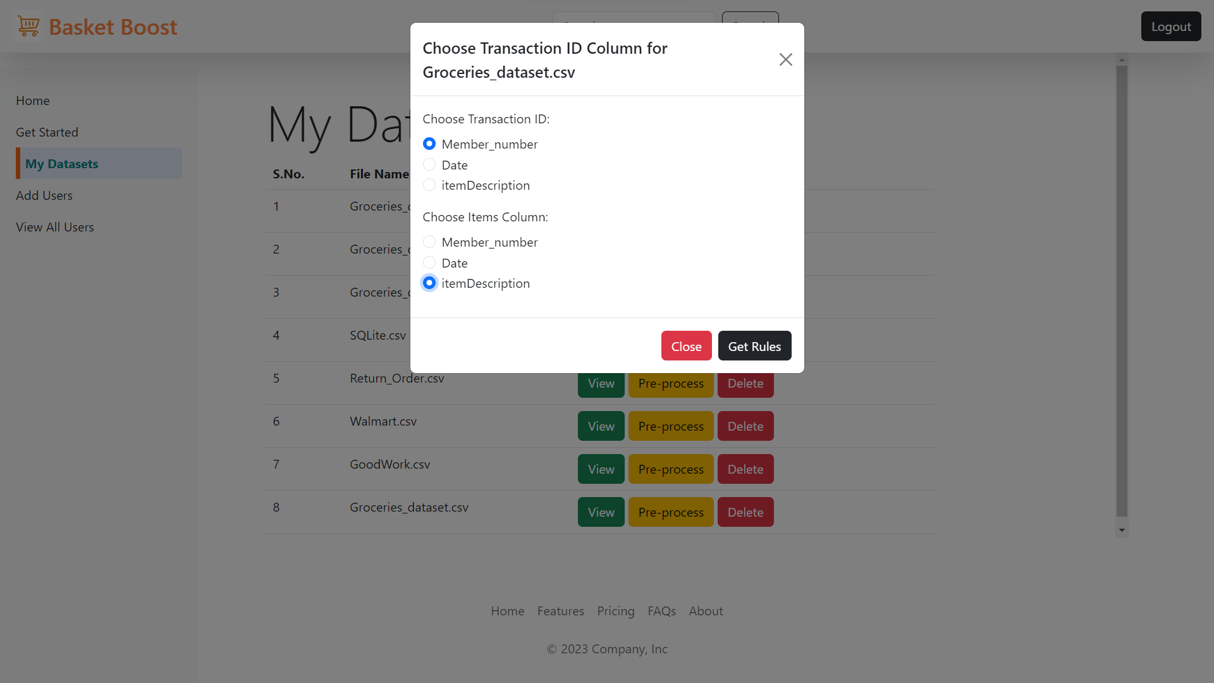

Slide 24
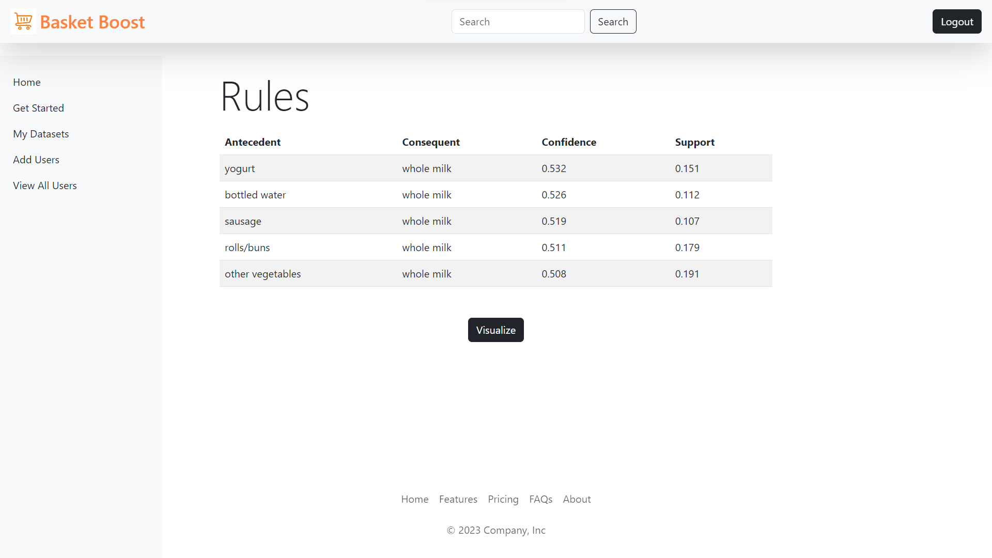

Slide 25
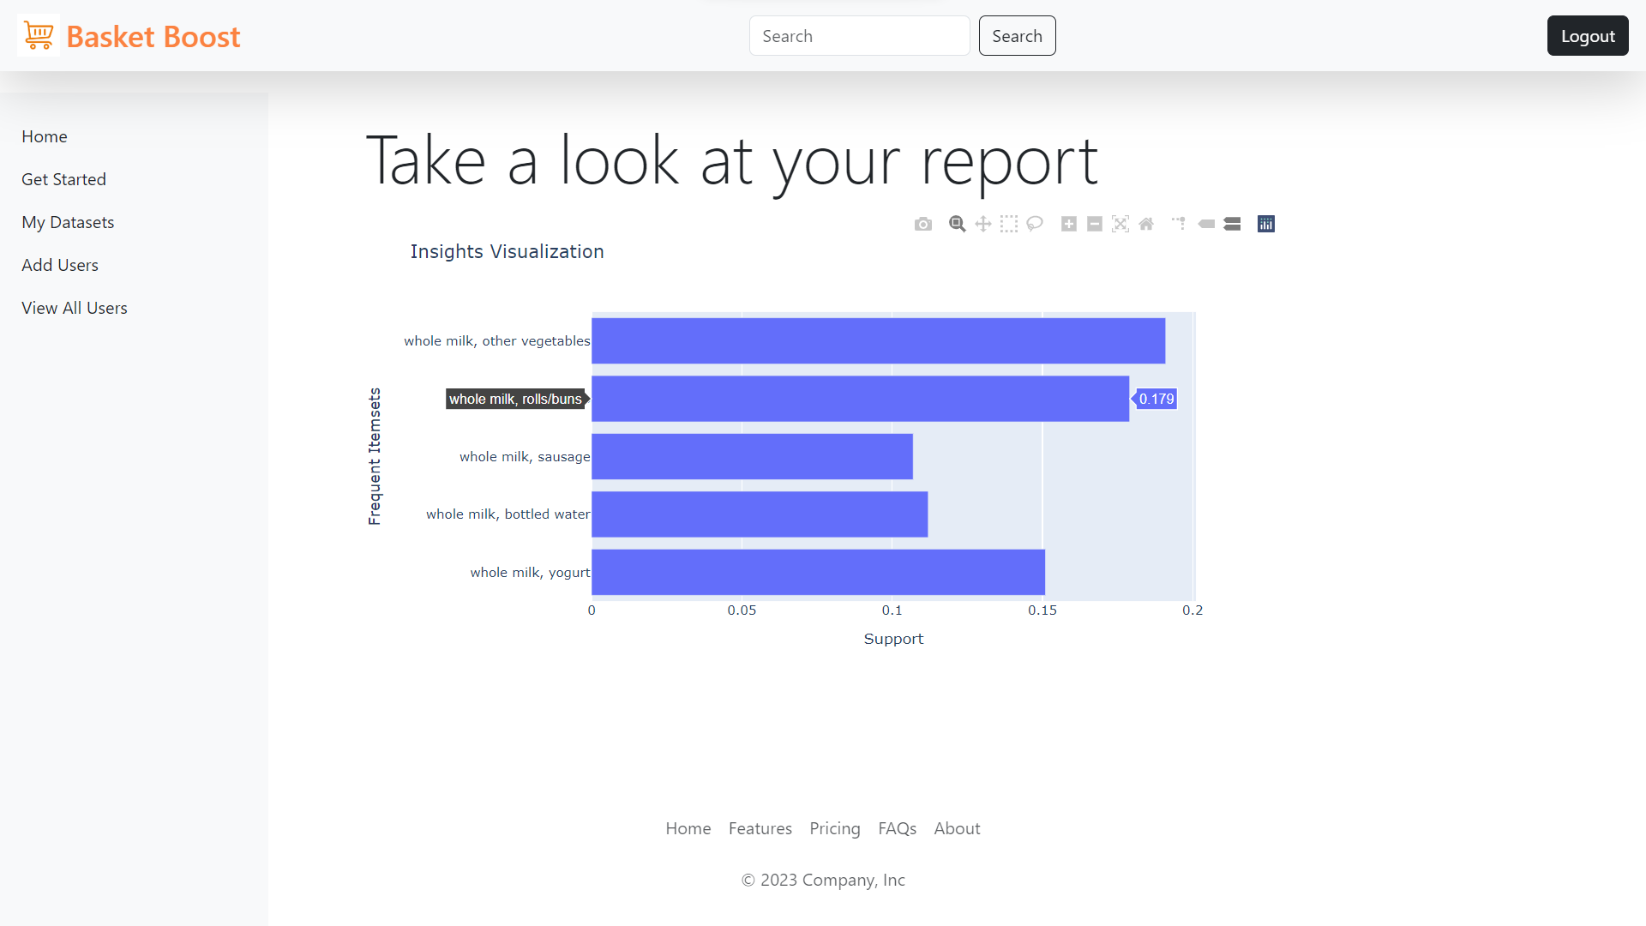

Slide 26
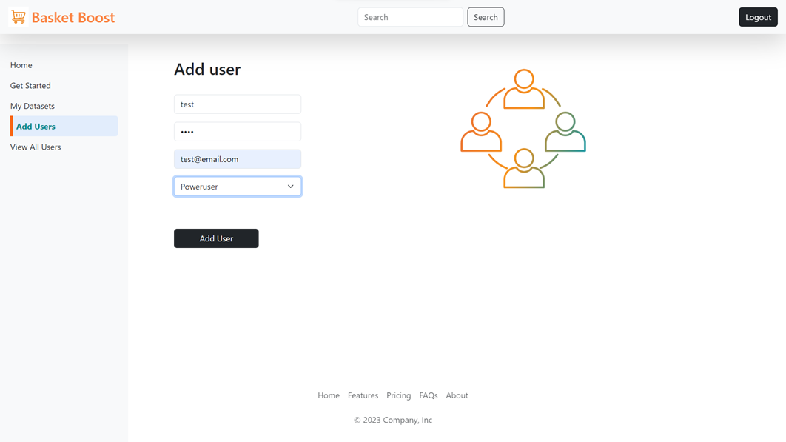

Slide 27
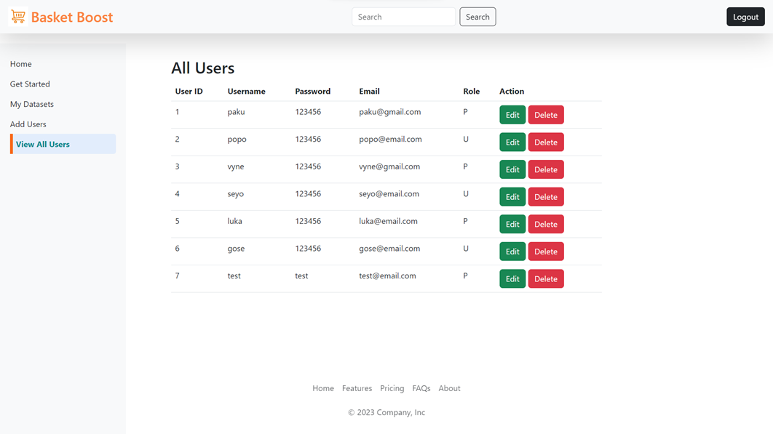

Slide 28
Table Structures
Basket-Boost Website

Slide 29
1. admin_details
Sr. No. | Column Name | Data Type | Constraint | Description
1. | admin_id | int | Primary Key | Unique identifier for each admin
2. | admin_username | varchar | Not Null | Username of the admin.
3. | admin_email | varchar | Not Null | Email address of the admin.
4. | admin_password | varchar | Not Null | Password of the admin.

Slide 30
2. user_details
Sr. No. | Column Name | Data Type | Constraint | Description
1. | user_id | int | Primary Key | Unique identifier for each user.
2. | username | varchar | Not Null | Username of the user.
3. | password | varchar | Not Null | Password of the user.
4. | role | ENUM('P', 'U') | Not Null | Password of the admin.
5. | email | varchar | Not Null | Role of the user(Poweruser/user)
6. | org_id | int | Foreign Key | References the organization to which the user belongs

Slide 31
3. db_files
Sr. No. | Column Name | Data Type | Constraint | Description
1. | file_id | int | Primary Key | Unique identifier for each file.
2. | file_name | varchar | Not Null | Name of the file.
3. | file_data | varchar | Not Null | Data/content of the file.
4. | user_id | int | Foreign Key | References the user who uploaded the file.

Slide 32
4. organization_details
Sr. No. | Column Name | Data Type | Constraint | Description
1. | org_id | int | Primary Key | Unique identifier for each organization.
2. | org_name | varchar | Not Null | Name of the organization.
3. | org_email | varchar | Not Null | Email address of the organization.
4. | org_location | varchar | Not Null | Location/address of the organization.

Slide 33
Limitations of the Proposed System
Basket-Boost Website

Slide 34
1. Scalability: System faces performance issues with growing data/user load, requiring optimization or infrastructure upgrades.
2. Internet Dependency: Heavy reliance on Internet connection; disruptions lead to user access and action problems.
3. Compatibility: Varies across browsers, OS, devices; may need configurations, impacting user experience.
4. Data Accuracy: Results' accuracy tied to input data quality; errors or incompleteness affect insights.
5. Security Risks: Lack of strong security measures risks breaches, leaks, unauthorized access.
6. Limited Techniques: Tool offers specific analysis methods; advanced techniques not available.
7. Maintenance & Updates: Regular upkeep needed for bugs, security, compatibility; neglect harms performance, security, and tech alignment.
Basket-Boost Website

Slide 35
Conclusion
Basket-Boost Website

Slide 36
In conclusion, the Market Basket Analysis Website Tool is invaluable for businesses seeking customer insights and sales optimization. Explored here are its objectives, functionalities, implementation, and enhancements.
The tool offers user-friendly data analysis through association rule mining, diverse data format support, and visualizations. It's built with HTML, Bootstrap, CSS, JavaScript, Flask, Python, and MySQL.
Acknowledging limitations like scalability, connectivity reliance, and security risks, solutions are feasible.
Future plans include advanced analytics, real-time analysis, customization, collaboration, and performance optimization, ensuring continued growth and effectiveness.
Basket-Boost Website

Slide 37
Office Address
Contact
Kindly contact us if you have any questions
NielsenIQ, HX65+387, ITTP, Vitthal Nagar, Kharadi, Pune, Maharashtra 411014
Hotline
9772986501
kusum.pareek@nielseniq.com

Slide 38

Thank You
For your attention!
Basket-Boost Website

